Slide 1
Front End Engineering-II Project
Team Details:
Divyanjali (2210990296)
Mugdha Jain (2210990585)
Nitika Bansal (2210990623)
Payal Dhiman (2210990647)
Faculty Coordinator:
Mr. Vikas patel
:
Chitkara University Institute of Engineering and Technology,
Chitkara University, Punjab

Slide 2
Table of Contents
Introduction
Problem Statement
Technical Details
Key Features
Project Highlights
Conclusion

Slide 3
Introduction
Food Delivery Service
This service allows users to order meals from their local restaurants as they please. Features such as browsing menus, customizing orders, creating a cart are also included. This service has been built using various front end technologies like JavaScript and React. This project has been worked on upon by a team whose members include-
Divyanjali
Mugdha Jain
Nitika Bansal
Payal Dhiman

Slide 4
Problem Statement
The problem at hand is the need for an effective and user-friendly web-based food ordering service. The application aims to streamline the ordering process and enhance user experience by providing an easy to use service with a wide range of food options that can be delivered to your doorstep by just the click of a button.

Slide 5
Technical Details
The project has been created using the following-
CSS:
CSS has been used for designing of the web page.
JAVASCRIPT:
JS has been used to create a dynamic and interactive web page to interact with visitors and execute complex actions.
React:
JS library used to build user interface.

Slide 6
Key Features
Alluring Design - It’s alluring design hooks the user on the webpage.
Intelligible - Through its simple design our food delivery service is easily accessible to the masses.
User authentication – To prevent bots from overwhelming the service user authentication feature has also been implemented.

Slide 7
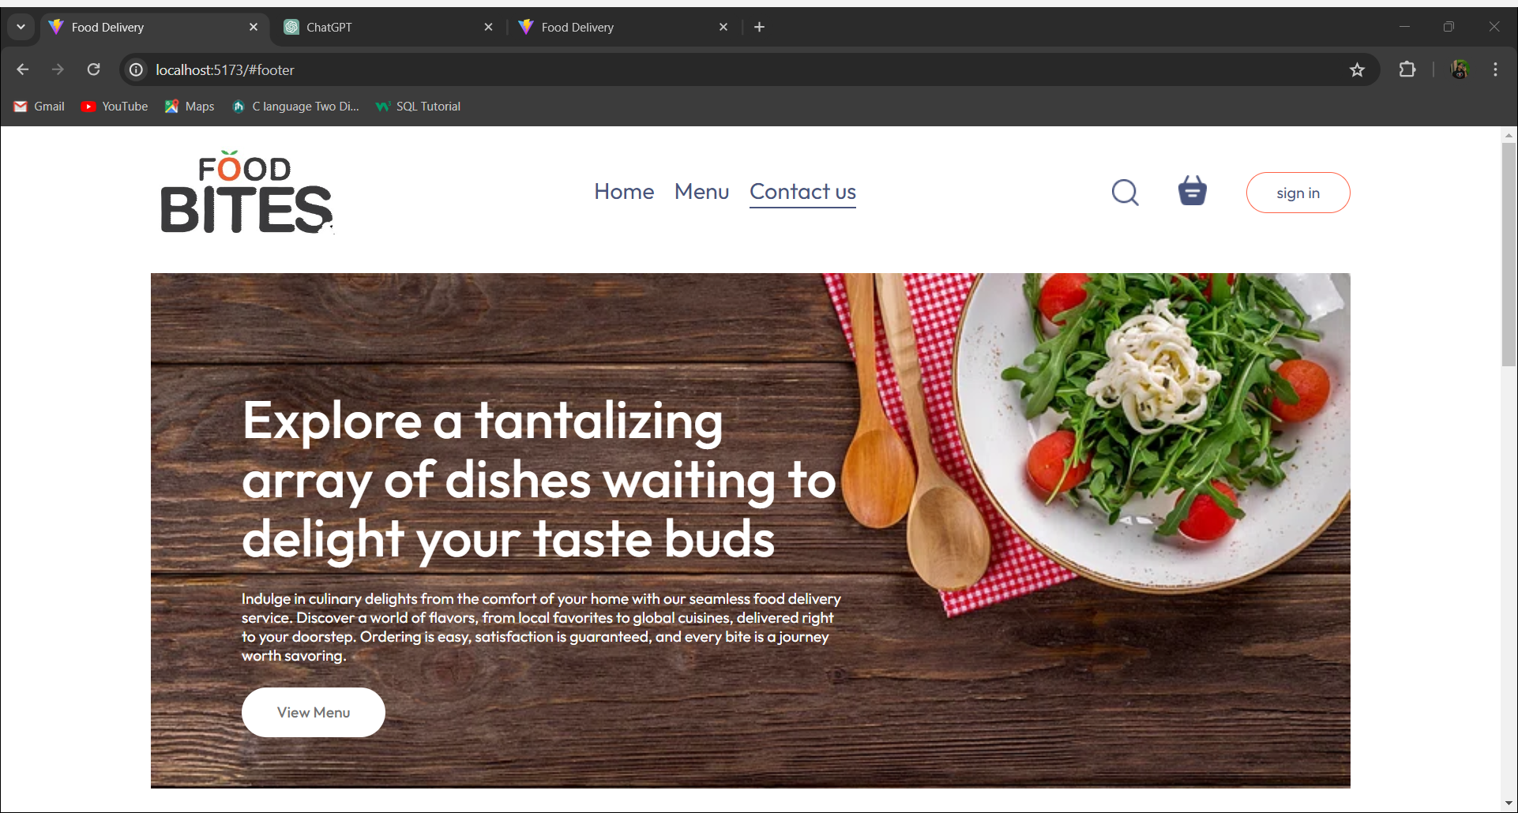
Project Highlights

Slide 8
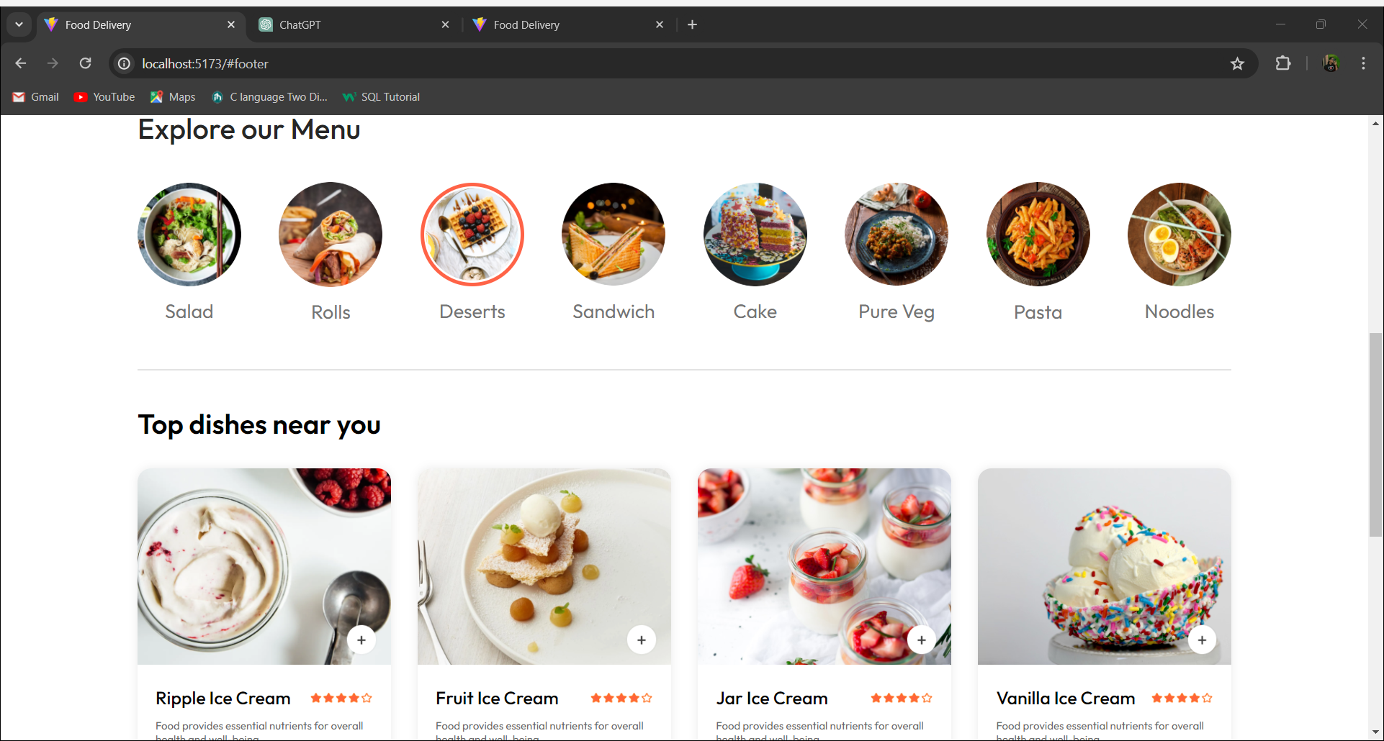
Project Highlights

Slide 9
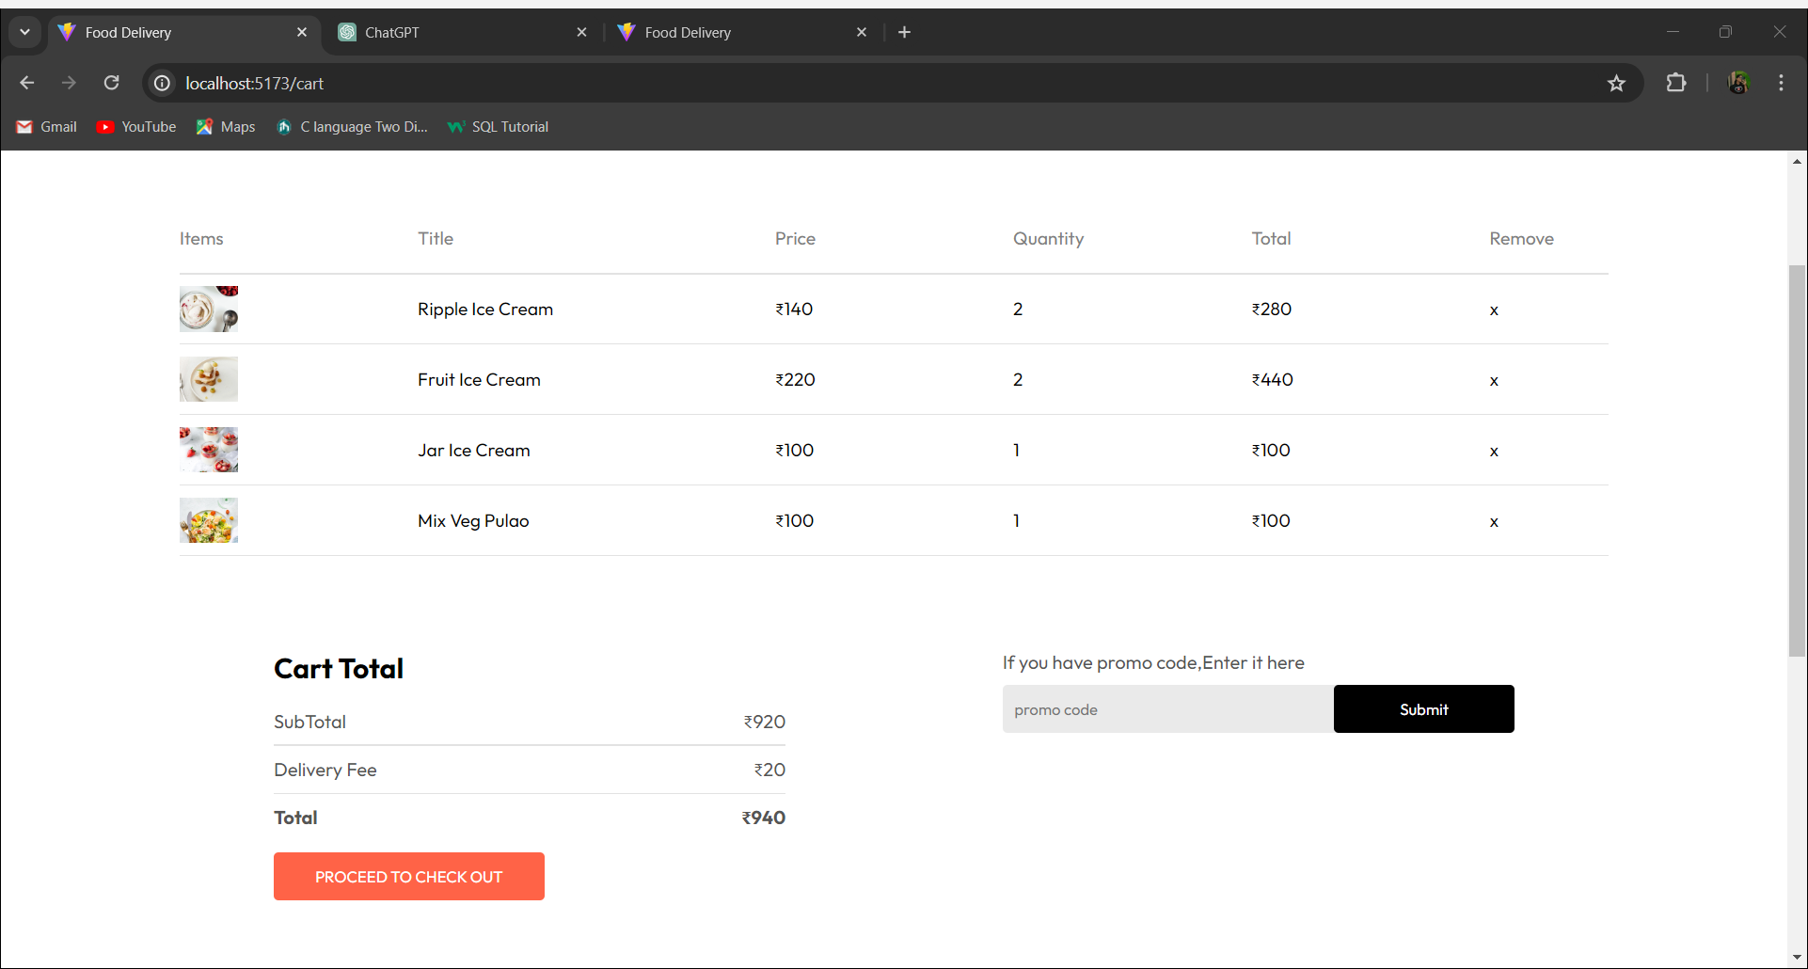
Project Highlights

Slide 10
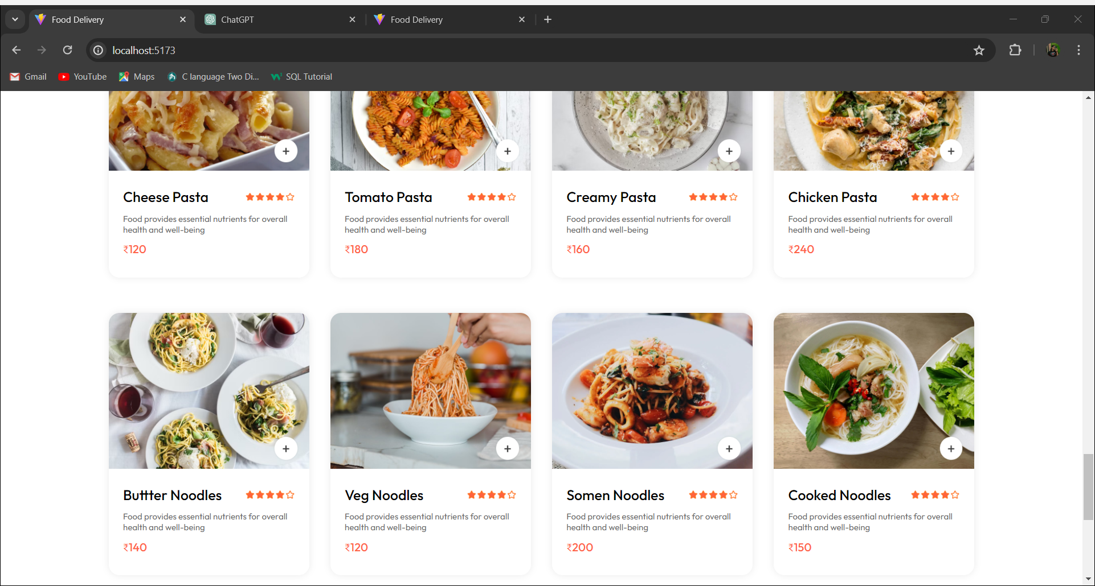
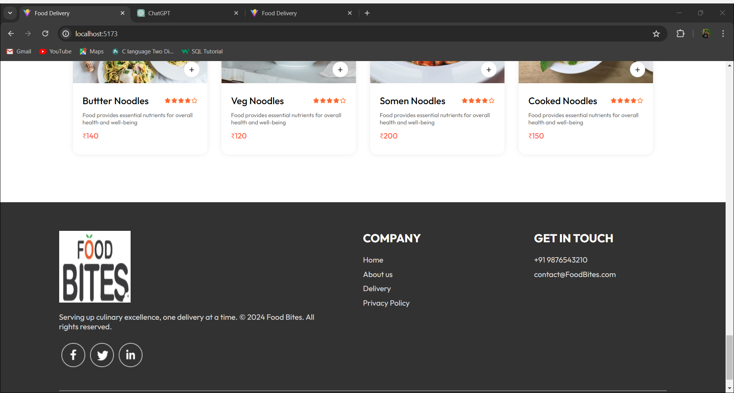
Project Highlights

Slide 11
Conclusion
In conclusion, the proposed design and methodology for our food delivery service harnesses the power of HTML, CSS, JavaScript and React js in a synergistic manner. The integration of various features like user authentication improves the responsiveness of the site . By focusing on user friendly design, we prioritize accessibility and simplicity, making our service easy to use.

Slide 12


